Slide 1
Table 7 Presents …
INDIVIDUAL LIABILITY IN CLAIMS AGAINST CORPORATE ENTITIES

Slide 2
Limited Liability Companies RSA 304-C:23
Except as provided in RSA 304-C:144, IV(b) and paragraph II:
The debts, obligations, and liabilities of a limited liability company, whether arising in contract, tort, or otherwise, shall be solely the debts, obligations, and liabilities of the limited liability company; and
No member or manager of a limited liability company shall be obligated personally for any such debt, obligation, or liability of the limited liability company solely by reason of being a member or acting as a manager of the limited liability company

Slide 3
Disposition of Unknown Claims Against Dissolved LLC RSA 304-C:144
IV(b) If the limited liability company has distributed its assets in liquidation, against a member of the limited liability company to the extent of the member's pro rata share of the claim or the assets of the limited liability company distributed to the member in liquidation, whichever is less. However, a member's total liability for all claims under this section shall not exceed the total amount of assets distributed to the member.

Slide 4
NH Business Corporation Act RSA 293-A
293-A:2.04 Liability for Preincorporation Transactions.
All persons purporting to act as or on behalf of a corporation, knowing there was no incorporation under this chapter, are jointly and severally liable for all liabilities created while so acting.

Slide 5
Liability of Shareholders RSA 293-A6.22
(b) Unless otherwise provided in the articles of incorporation, a shareholder of a corporation is not personally liable for the acts or debts of the corporation except that he or she may become personally liable by reason of his or her own acts or conduct

Slide 6
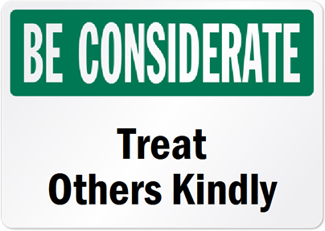
HOSTILE WORK ENVIRONMENT = conduct “so severe or pervasive that it create[s] a work environment abusive to employees.”

Slide 7
Hostile Work Environment
Membership in a protected class,
Subjection to unwelcome conduct,
Conduct that is based on membership in the protected class,
Conduct that is sufficiently severe or pervasive so as to alter the terms and conditions of employment,
Conduct that is both objectively and subjectively offensive, and
A basis for employer liability

Slide 8
Title VII Retaliation
He or she undertook protected conduct
His or her employer took adverse action against them, and
A causal nexus exists between the protected conduct and the adverse action.

Slide 9
Employer Liability
Traditionally, limited to employers for permitting unlawful discriminatory practices to occur. Employees and owners were exempt from liability in their individual capacity.

Slide 10
The Fred Fuller Oil Co. Decision
Whether RSA 354-A:2 and 354-A:7 impose individual employee liability for aiding and abetting discrimination in the workplace,
Whether RSA 354-A:19 imposes individual employee liability for retaliation in the workplace.

Slide 11
In the employment context, it is an unlawful discriminatory practice to aid and abet an employer to commit an unlawful discriminatory practice =
Claims may be brought against any “PERSON, employer, labor organization, employment agency or public accommodation…”

Slide 12
NH Dram Shop Law RSA 507-F

Slide 13
507-F:4 Negligent Service of Alcoholic Beverages – Innocent Person
507-F:5 Reckless Service of Alcoholic Beverages – Intoxicated Person

Slide 14
I. A defendant who negligently serves alcoholic beverages to a minor or to an intoxicated person is liable for resulting damages, subject to the provisions of this chapter.
II. Service of alcoholic beverages to a minor or to an intoxicated person is negligent if the defendant knows or if a reasonably prudent person in like circumstances would know that the person being served is a minor or is intoxicated.
VII. A defendant is not under a duty to recognize signs of a person's intoxication other than those normally associated with the consumption of alcoholic beverages except for intoxication resulting in whole or in part from other drugs consumed on defendant's premises with defendant's actual or constructive knowledge.

Slide 15
Defense - “Responsible business practices” are those business policies, procedures and actions that a reasonably prudent person would follow in similar circumstances.

Slide 16
Individual Liability
507-F:3 Defendants. – Any PERSON licensed or required to be licensed under RSA 178:1, I and ANY EMPLOYEE OR AGENT OF SUCH PERSON who commits an act giving rise to liability, as provided in RSA 507-F:4 and 5, may be made a defendant to a claim under the provisions of this chapter.

Slide 17
PIERCING THE CORPORATE VEIL AND SUCCESSOR LIABILITY FOR TRANSFERRED ASSETS

Slide 18
Corporate Formalities
Must keep identity of the entity separate
Cannot remove assets from the entity before paying creditors

Slide 19
Veil pierced when …
Corporate identity to promote injustice or fraud
Shareholder “creates a false appearance which causes a reasonable creditor to misapprehend the worth of the corporate obligor.”
Peter R. Previte, Inc. v. McAllister Florist, Inc., 113 N.H. 579, 582 (1973)

Slide 20
Uniform Fraudulent Transfer Act RSA 545-A
A transfer of a debtor’s assets is fraudulent as to an existing creditor of the debtor when …

Slide 21
… the debtor makes a transfer or incurs an obligation without receiving reasonably equivalent value in exchange and the debtor was insolvent at the time or was made insolvent by the transfer or obligation.
RSA 545-A:5, I.

Slide 22
…the transfer is made to an insider (such as an officer, director or member) for an antecedent debt, the debtor was insolvent at the time of transfer, and the insider has reasonable cause to believe that the debtor was insolvent.
RSA 545-A:5, II.

Slide 23
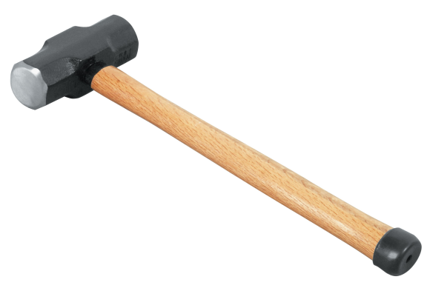
Creditors can us it to impose direct liability on company insiders who wrongfully take assets without first paying company debts, but it can also be used against third parties who receive the fraudulent transfers

